Slide 1
World Happiness Report Dataset
Data Visualization and Prediction
CZ1015 INTRO TO DATA SCIENCE
MINI-PROJECT PRESENTATION
DONE BY: XIAO YANG
WONG CHUN FOONG
KEANE NGUYEN KIM XUYEN

Slide 2
First, let’s look into our…
Background
What will be the
World’s Happiness Score in the next 5 years?
DATASET
CHOSEN
CLEAN
DATASET
UNDERSTAND
DATASET
First, we choose the 2019 WHR dataset
Next, we prepare the dataset by filling N.A.s with 0s and mapping regions and country codes to respective country
Then, we use the data to visualize and predict the data to answer our above question
Visualization
Analysis
Prediction
Outcome
Conclusion

Slide 3
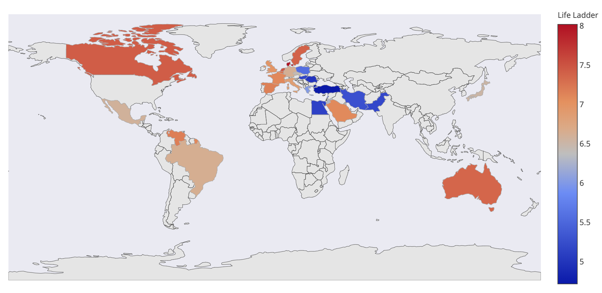
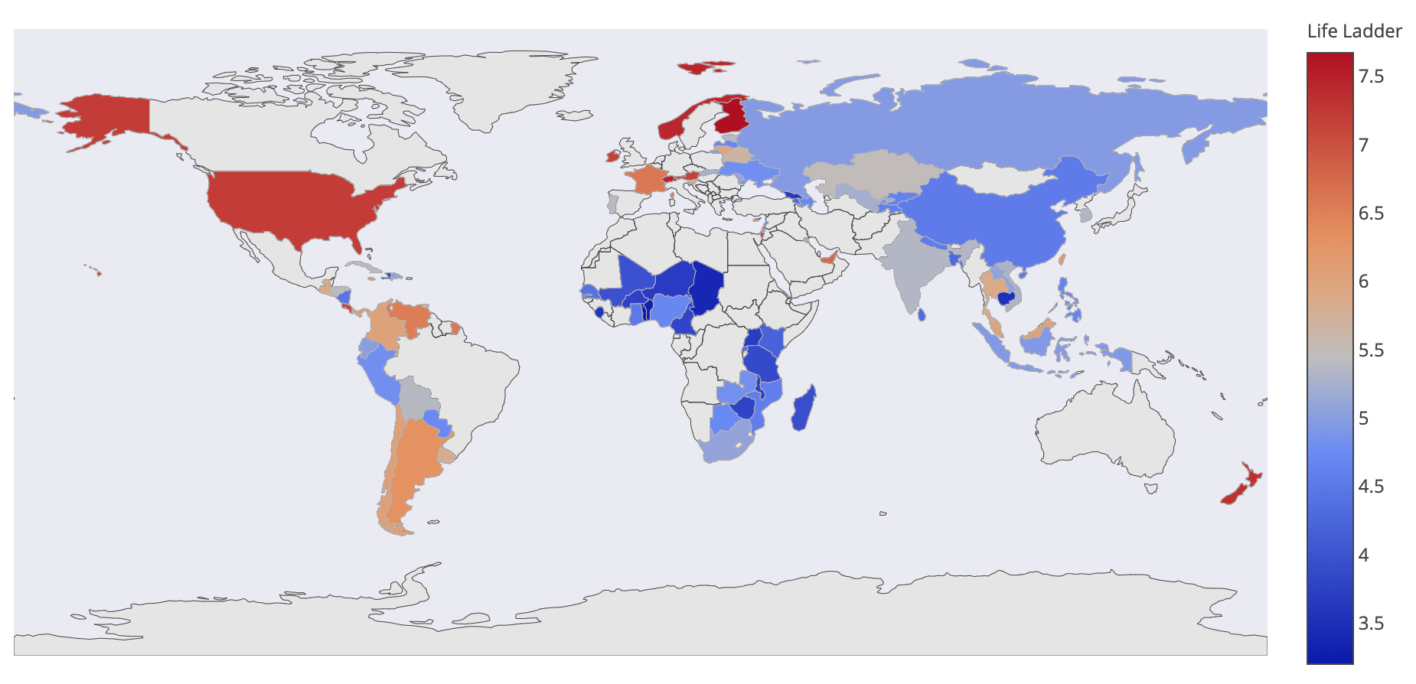
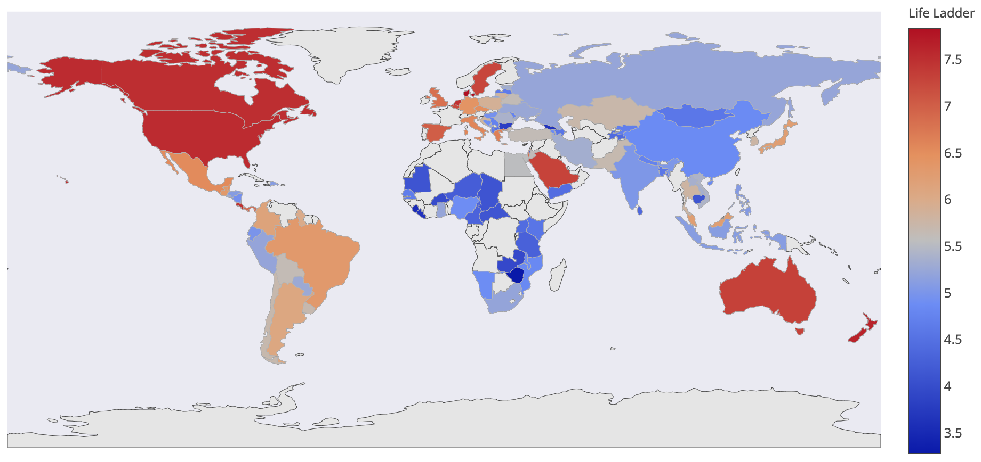
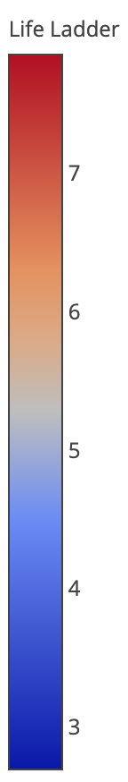
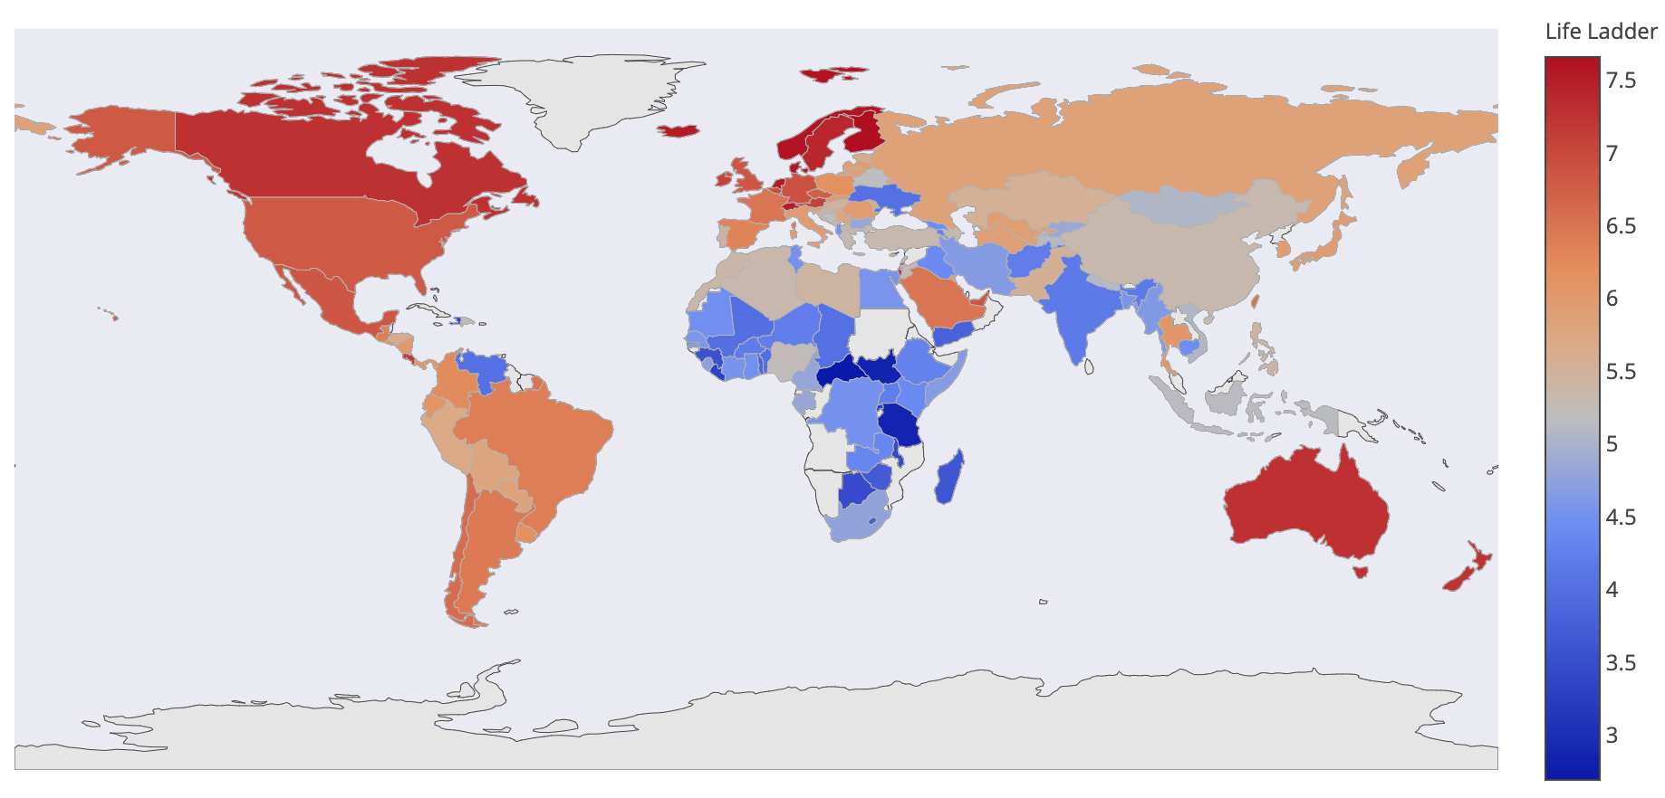
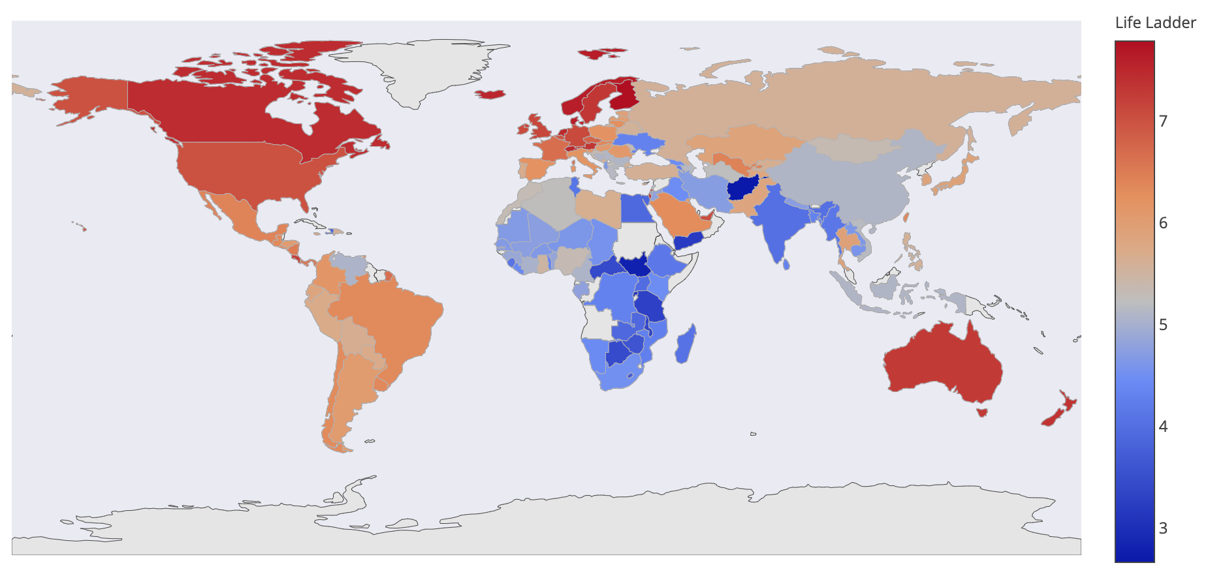
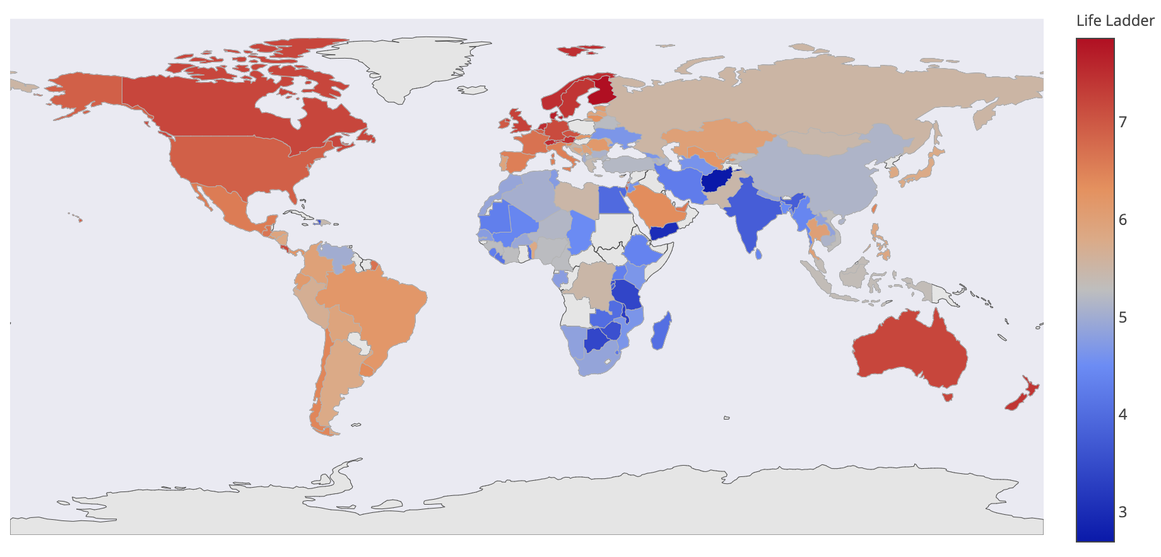
Now, let’s take a look at our…
Visualization
2005
2006
2007
2016
2017
2018
Background
Analysis
Prediction
Outcome
Conclusion

Slide 4
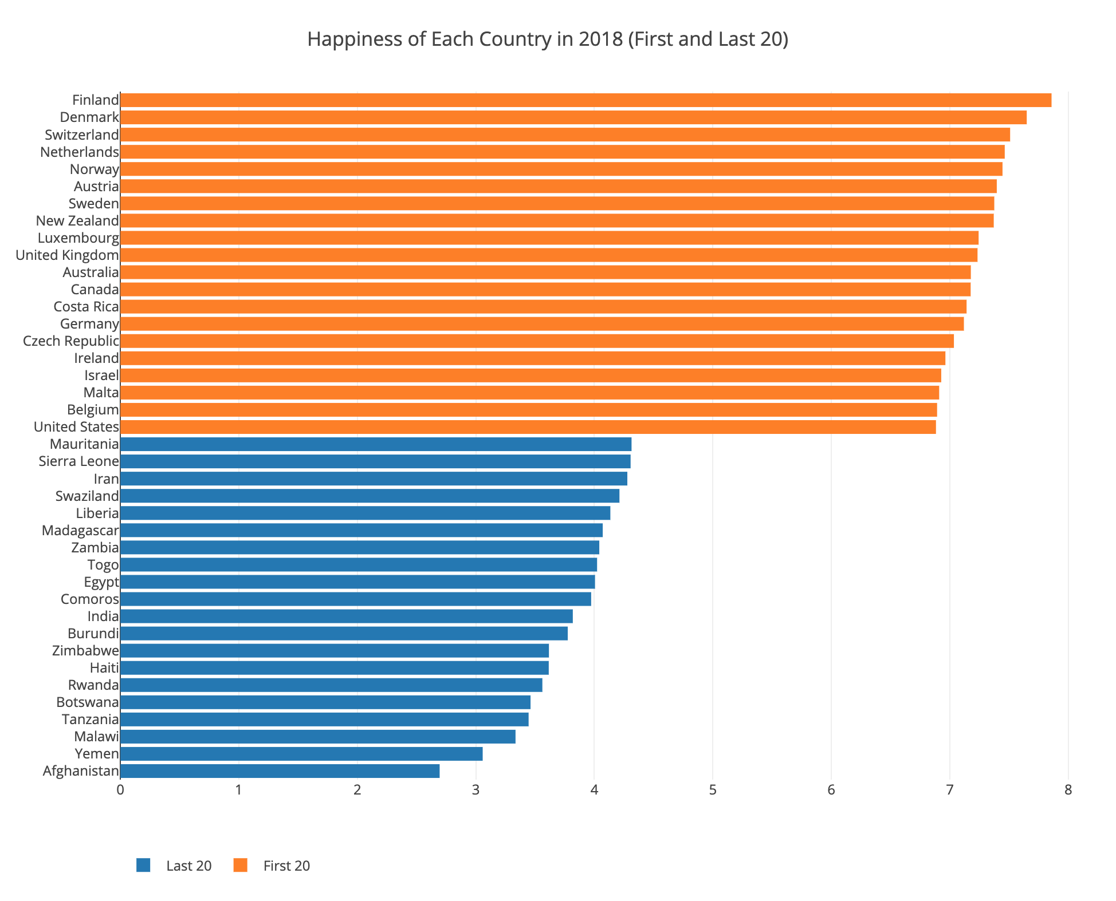
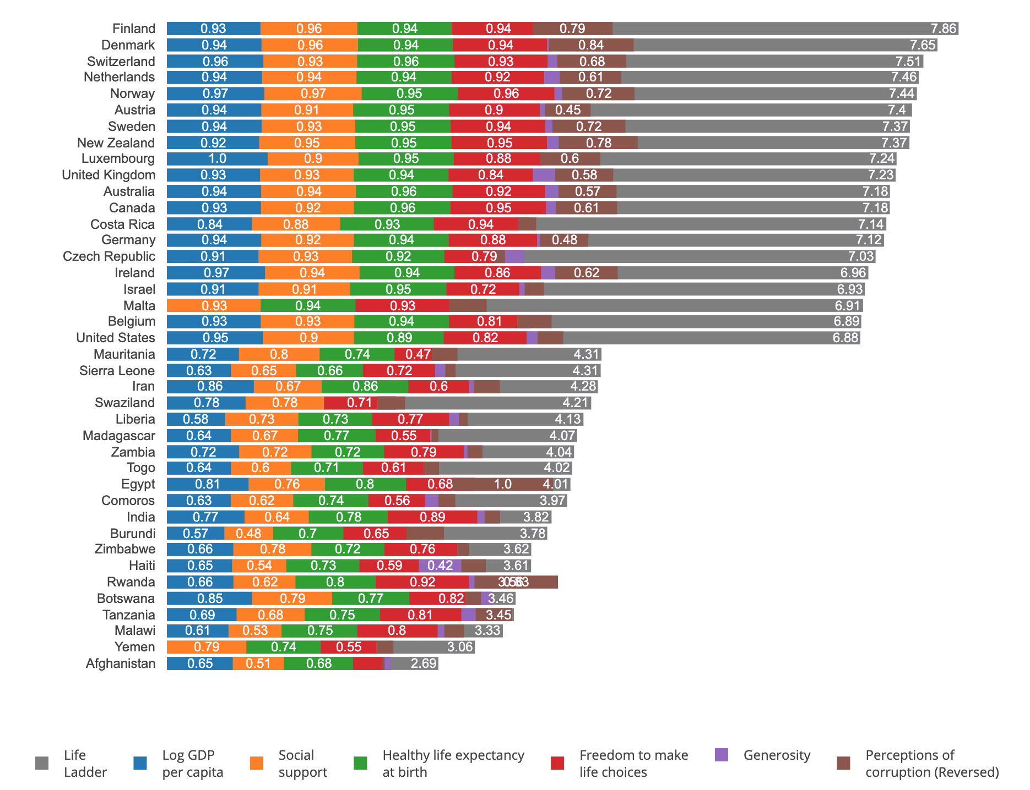
Now, let’s take a look at our…
Visualization
Countries' Happiness Scores in 2018 (First and Last 20)
Breakdown of Countries' Happiness Scores in 2018 (First and Last 20)
Background
Analysis
Prediction
Outcome
Conclusion

Slide 5
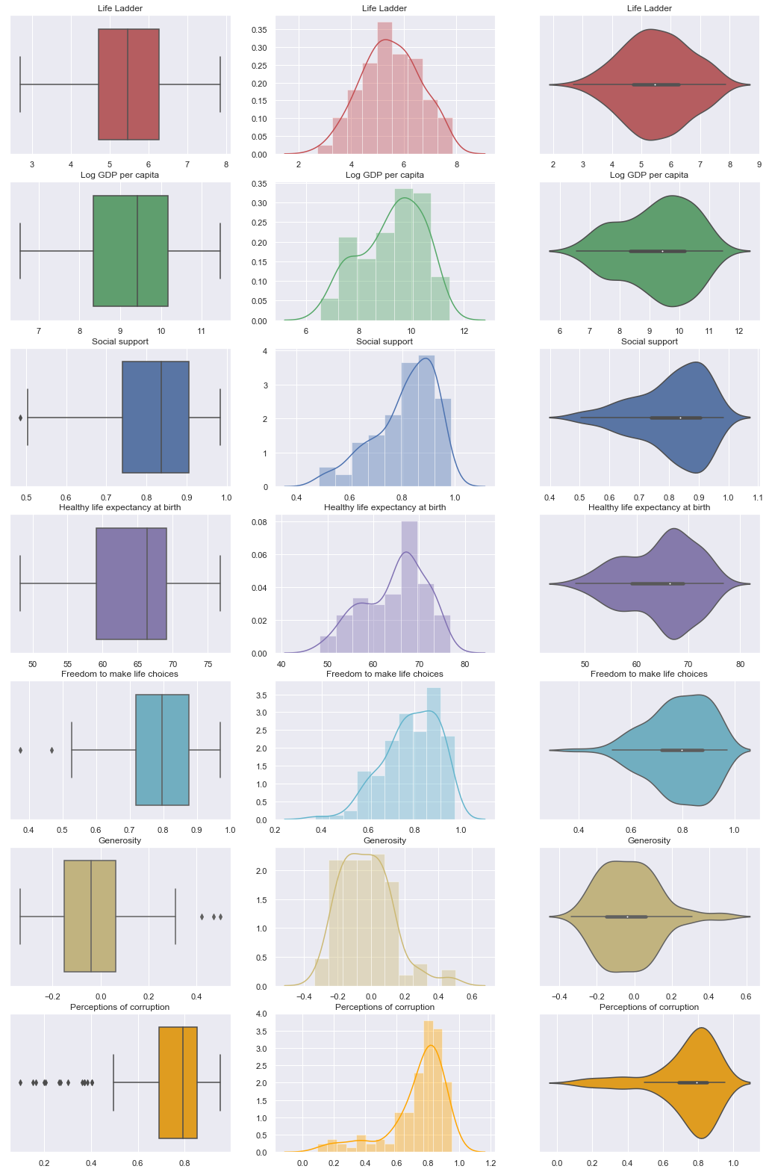
Now, let’s take a look at our…
Visualization
Background
Analysis
Prediction
Outcome
Conclusion

Slide 6
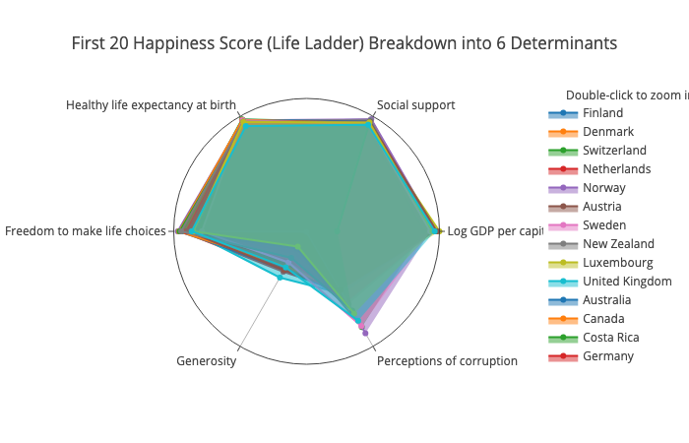
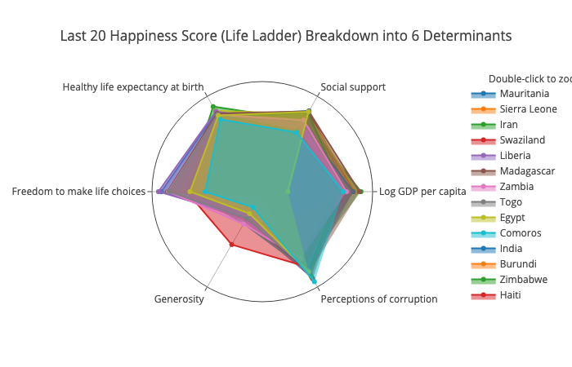
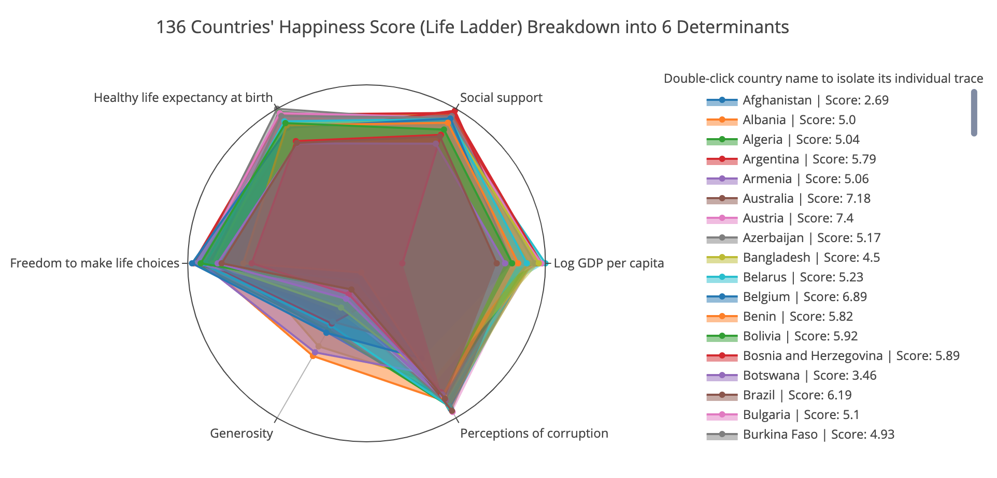
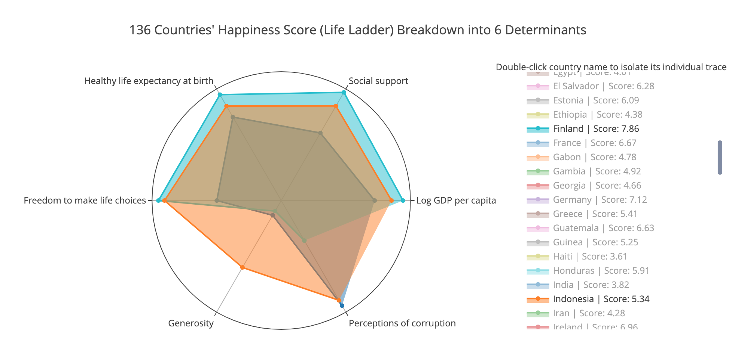
Now, let’s take a look at our…
Visualization
First 20 Happiness Score (Life Ladder) Breakdown into 6 Determinants
Last 20 Happiness Score (Life Ladder) Breakdown into 6 Determinants
136 Countries' Happiness Score (Life Ladder) Breakdown into 6 Determinants
Comparing Happiest, Unhappiest, and Most Generous Countries
Background
Analysis
Prediction
Outcome
Conclusion

Slide 7
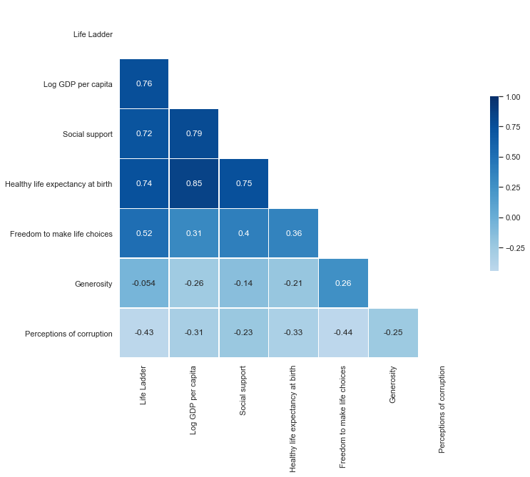
Now, let’s take a look at our…
Visualization
Background
Analysis
Prediction
Outcome
Conclusion

Slide 8
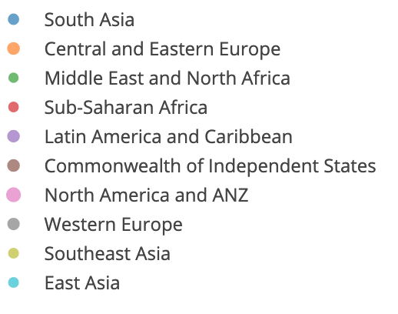
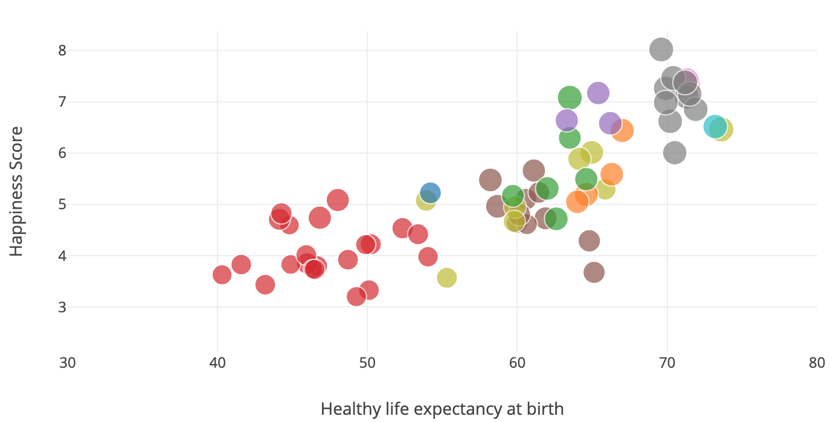
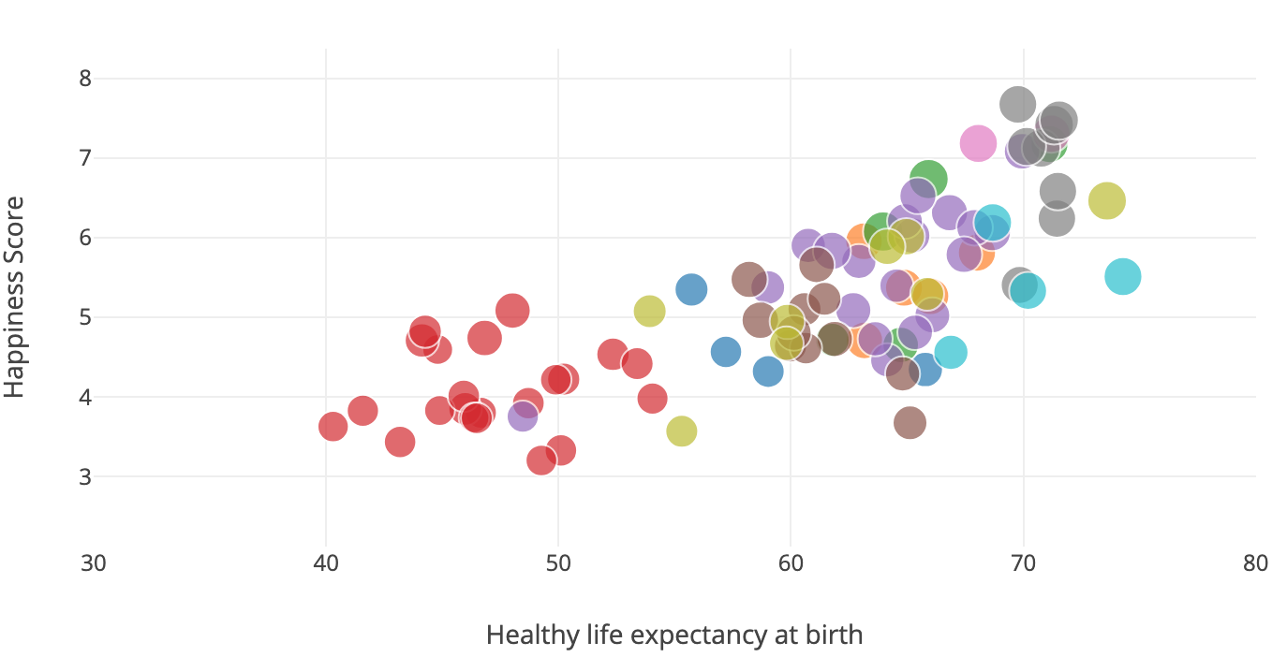
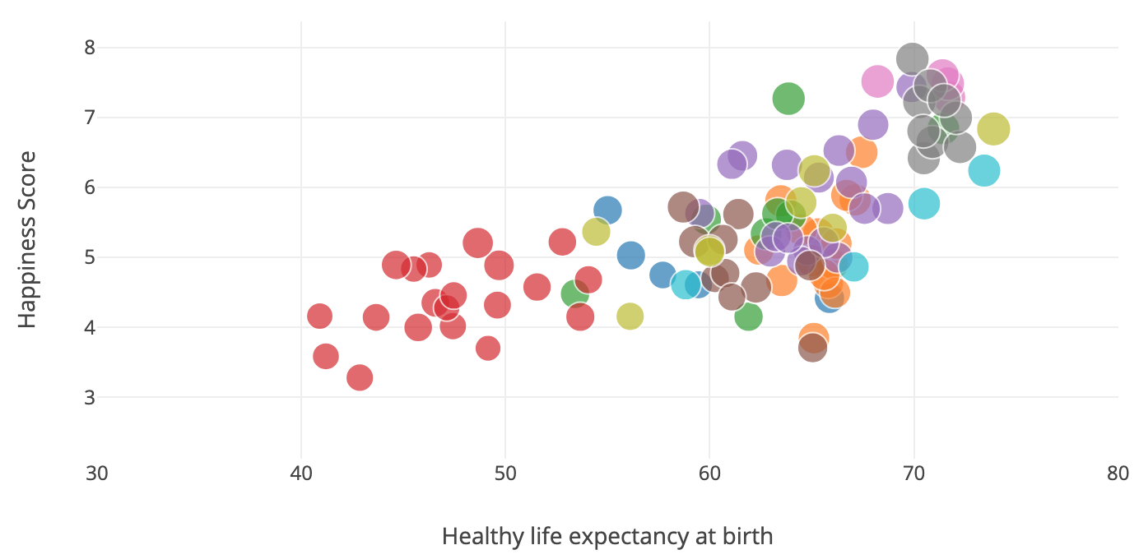
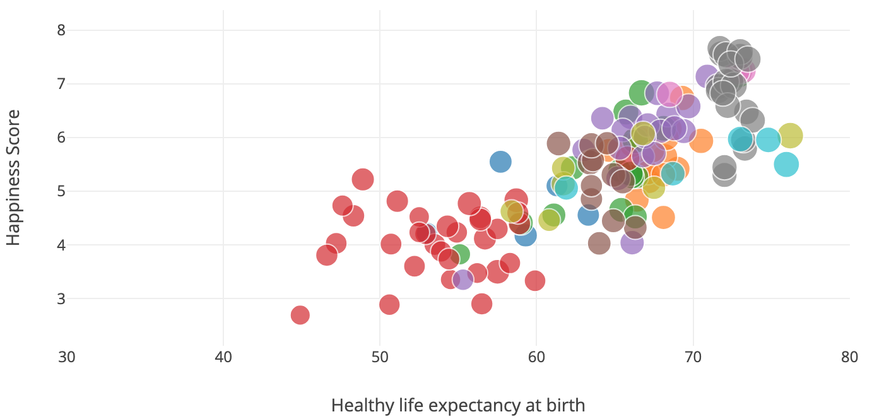
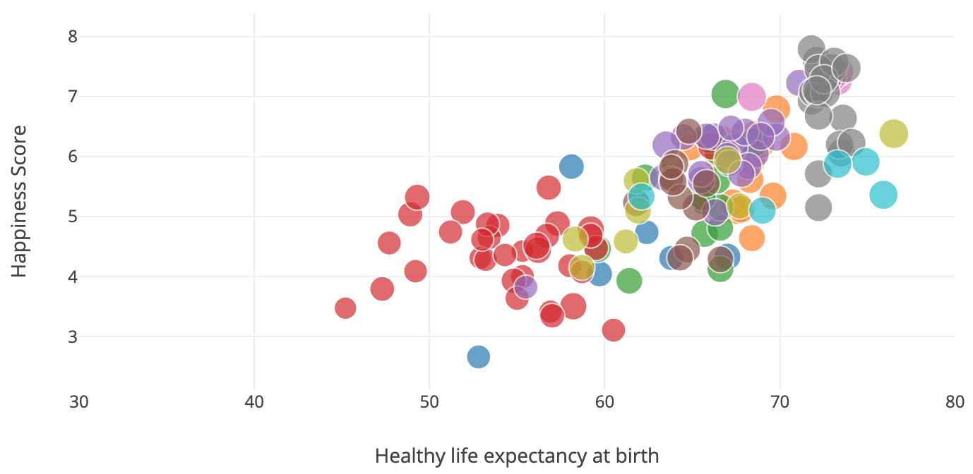
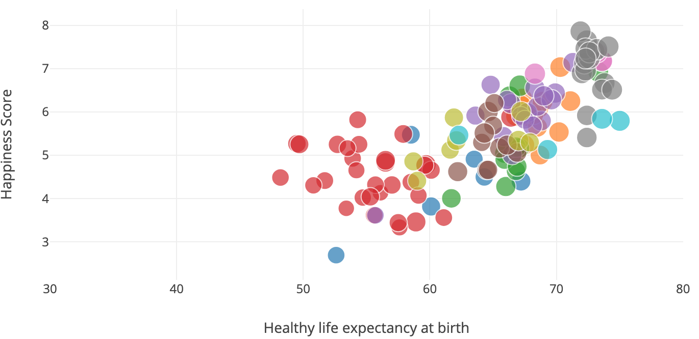
Now, let’s take a look at our…
Visualization
2005
2006
2007
2016
2017
2018
Background
Analysis
Prediction
Outcome
Conclusion

Slide 9
Now, let’s take a look at our…
Prediction
Predict each index for each country
Use the predicted indexes to predict happiness
Background
Visualization
Analysis
Outcome
Conclusion

Slide 10
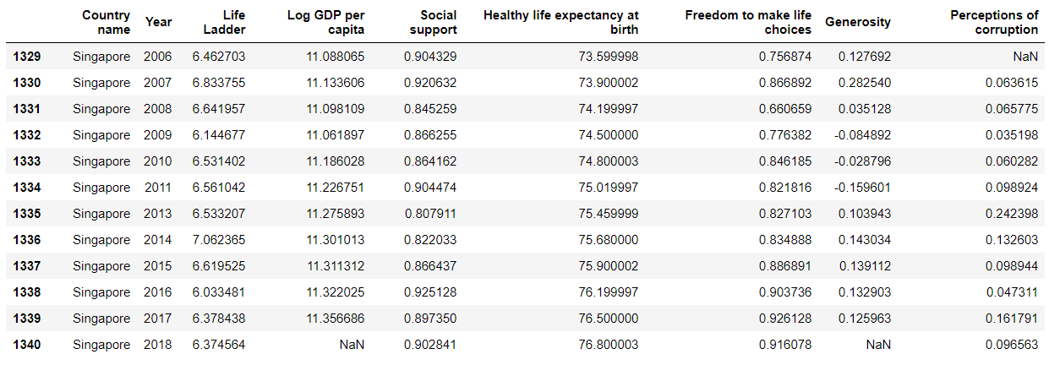
Now, let’s take a look at our…
Prediction
uni-variate linear regression for each column index
Predictions:
Background
Visualization
Analysis
Outcome
Conclusion

Slide 11
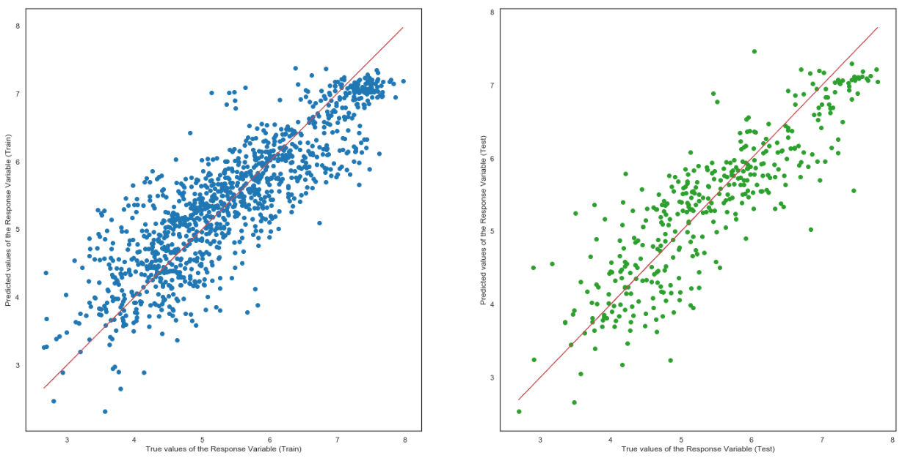
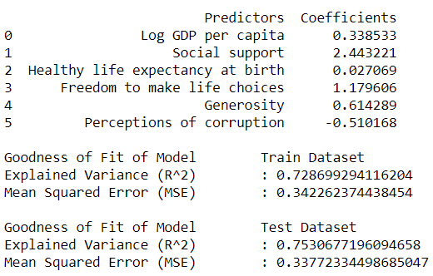
Prediction
√ after predicting the indexes for each country...
Predict happiness for each country by using all 6 indexes
Multi-variate Linear Regression
Background
Visualization
Analysis
Outcome
Conclusion

Slide 12
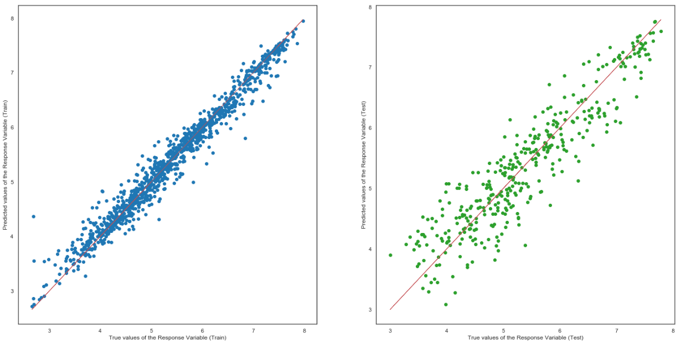
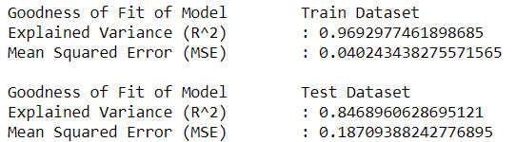
Prediction
Random Forest Regression
Background
Visualization
Analysis
Outcome
Conclusion

Slide 13
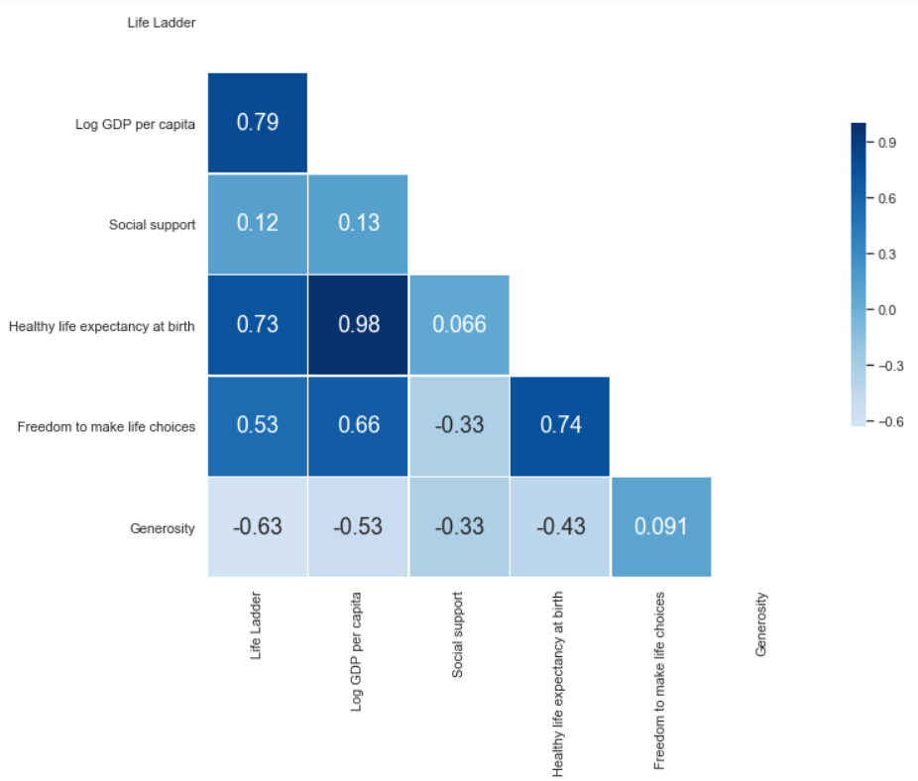
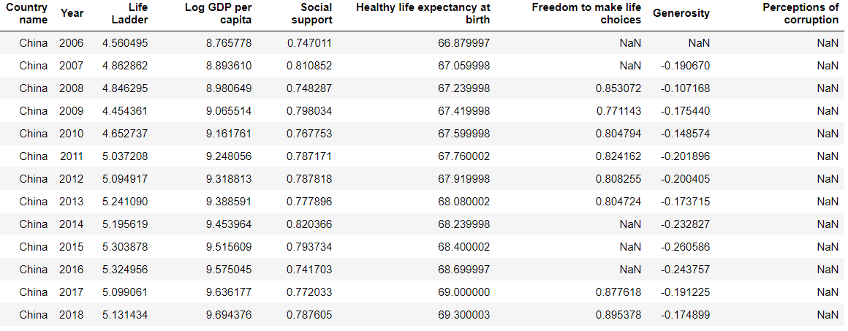
Prediction
Highest Correlation
Regression is great enough, but stats are not so ideal...
Uni-variate Linear Regression
Background
Visualization
Analysis
Outcome
Conclusion

Slide 14
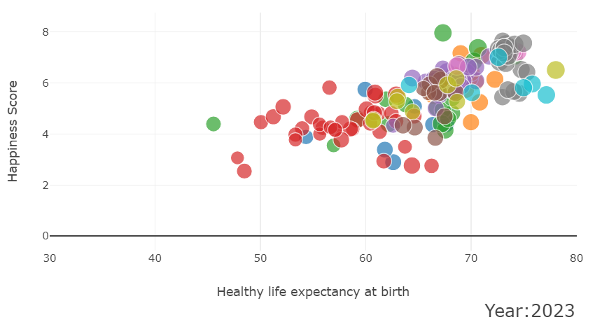
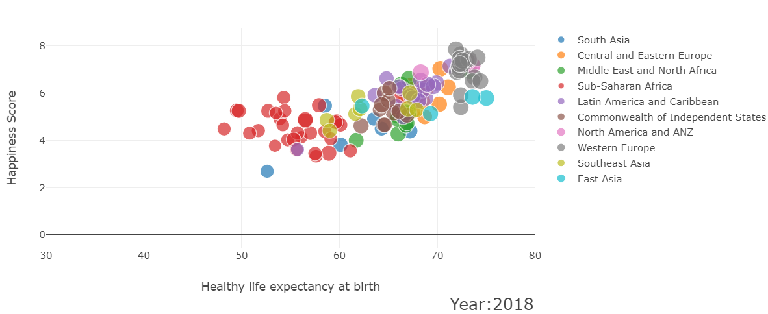
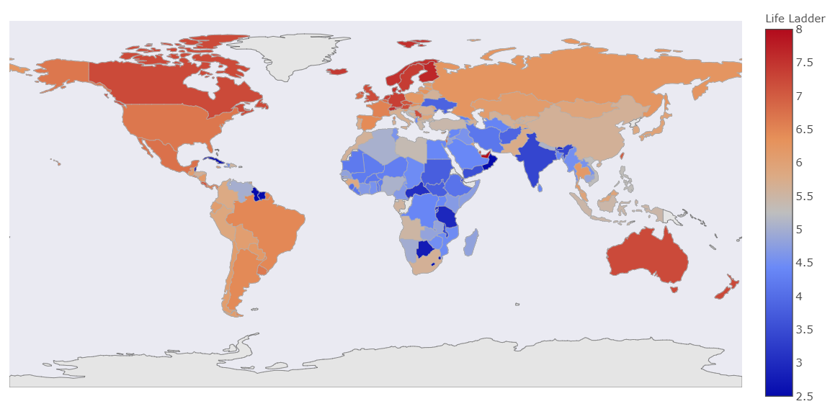
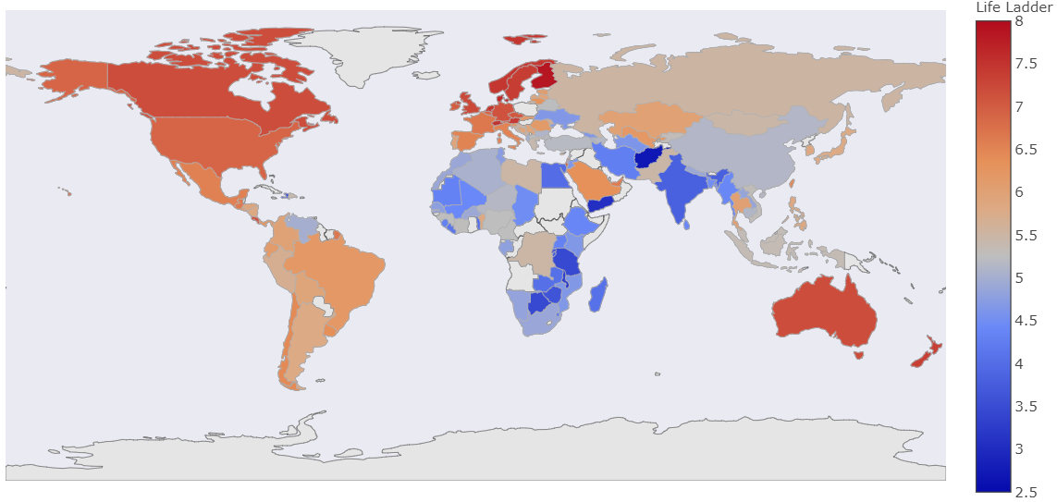
Prediction
World Happiness - Year 2018
World Happiness - Year 2023
Background
Visualization
Analysis
Outcome
Conclusion

Slide 15
So, what is our…
Outcome
Did we achieve our objective
Anything interesting
Background
Visualization
Analysis
Prediction
Conclusion

Slide 16
Finally, for our…
Conclusion
Learning points
Challenges
Background
Visualization
Analysis
Prediction
Outcome

Slide 17
Thanks for tuning in! Any Question?
Random data

